Slide 1
GradMatch
Job Matching App for Recent College Graduates
Product Owner: Oluwademilade Awoyomi
© 2019 Udacity. All rights reserved.

Slide 2
Background
Why Are We Here?
Graduating from college can be both exciting and daunting. Often, recent college graduates find it challenging to navigate the job market, particularly finding the best job suited to their skills and preferences. GradMatch is a mobile app that will help college graduates to find the best job matching their skills and preferences.
© 2019 Udacity. All rights reserved.

Slide 3
Business Case
© 2019 Udacity. All rights reserved.
Notes:
[ALL PARTICIPATION]

Slide 4
Initial Focus
Where are we starting?
GradMatch will initially focus on recent college graduates who are looking for job opportunities that align with their skills and preferences. Our goal is to acquire 10,000 users within the first six months of launch. We plan to achieve this by:
Conducting targeted social media ads on LinkedIn and Facebook to reach recent college graduates
Partnering with universities and career centers to promote GradMatch
Providing referral incentives to users who invite their friends to use GradMatch
© 2019 Udacity. All rights reserved.

Slide 5
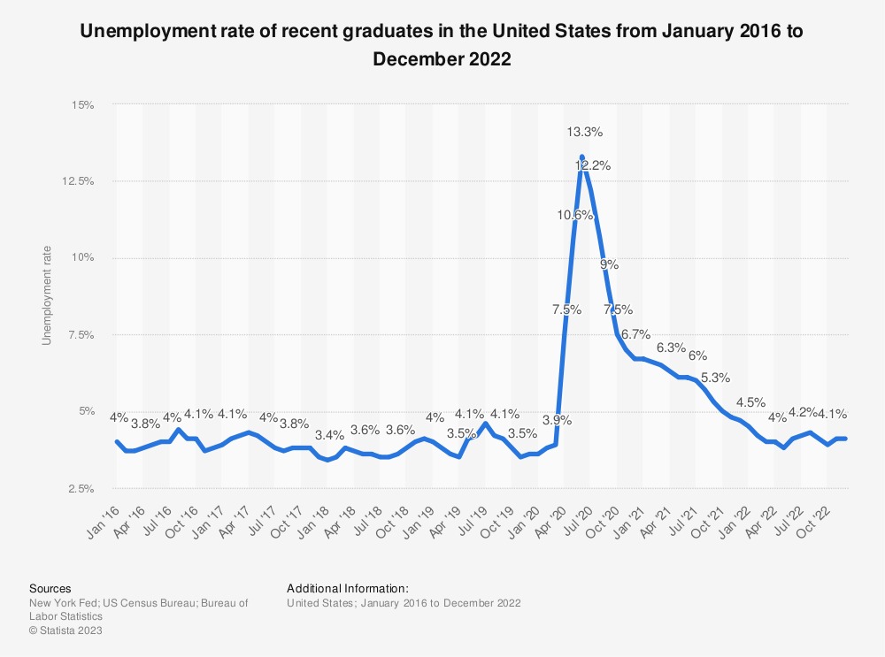
Opportunity
What’s the problem?

Slide 6
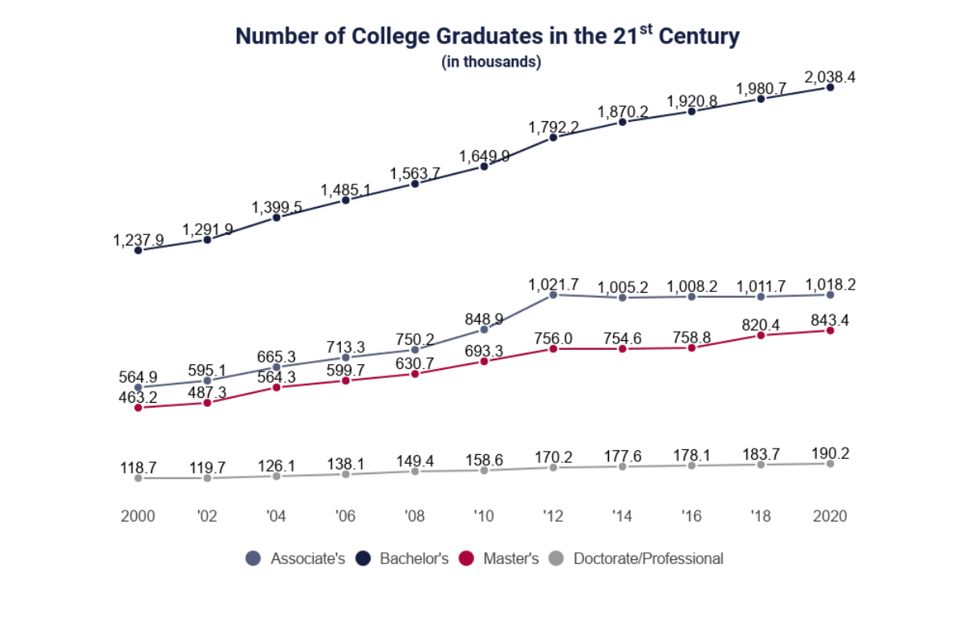
Opportunity
What’s the problem?

Slide 7
Opportunity
What’s the problem?
The global online recruitment market size is anticipated to reach USD 43.39 billion till 2027. This information is provided by Fortune Business Insights™, in its report, titled, “Online Recruitment Market.(https://www.fortunebusinessinsights.com/online-recruitment-market-103730)
According to the National Center for Education Statistics, over 2.1 million students are expected to graduate with a bachelor's degree in the US in 2022.
Studies show it takes recent graduates within an average of 6-9 months to land a job.
From the graph in previous slide, As at September 2022, about four percent of recent college graduates were unemployed in the United States. This was a significant decrease from September 2020, when the unemployment rate among recent college graduates was at nine percent.
Essentially, there is a significant opportunity to provide these graduates with an app that can simplify the job search process.
© 2019 Udacity. All rights reserved.

Slide 8
Proposal
What’s Our Solution?
: GradMatch will use data from LinkedIn's vast network to recommend jobs based on the user's skills, education, and experience. The app will use a smart algorithm to match job postings with the user's profile and preferences. The app will allow the user to swipe left or right to show interest in a job, similar to popular dating apps. The app will also provide career advice, job market insights, and interview preparation tips.
© 2019 Udacity. All rights reserved.

Slide 9
Return On Investment
Budget for the First Year:
Salaries and Benefits:
2 Developers: $100,000 each
1 Tester: $80,000
1 Business Analyst: $90,000
1 Tech Lead: $120,000
Total Cost: $490,000
Marketing:
Social Media Ads: $50,000
Influencer Marketing: $20,000
Email Marketing: $15,000
PR: $30,000
Total Cost: $115,000
Platform Development:
Server Costs: $20,000
Software Tools and Licenses: $10,000
IT Support and Maintenance: $20,000
Total Cost: $50,000
Total Budget for First Year: $655,000
Assumptions:
Revenue per user: $20/month
Users acquired in the first year: 10,000
ROI Calculation:
Net Return on Investment = Total Revenue - Total Cost = ($20 x 10,000 x 12) - $655,000 = $545,000
ROI = (Net Return on Investment / Cost of Investment) x 100%
ROI = ($545,000 / $655,000) x 100% = 83.21%
Based on our assumptions, GradMatch has the potential to generate $545,000 in net return on investment in the first year, resulting in an ROI of 83.21%. This means that for every $1 invested in GradMatch, we can expect to see a return of $1.83.
© 2019 Udacity. All rights reserved.

Slide 10
Measurement
How will we know if we’re successful?
GradMatch will measure success through user acquisition, retention rate, user engagement, conversion rates, and revenue generated. We anticipate that GradMatch will generate $5 million in revenue in the first year through a freemium model, with the basic features being free, and advanced features available through a subscription
© 2019 Udacity. All rights reserved.

Slide 11
Competitors
© 2019 Udacity. All rights reserved.
Notes:
[ALL PARTICIPATION]

Slide 12
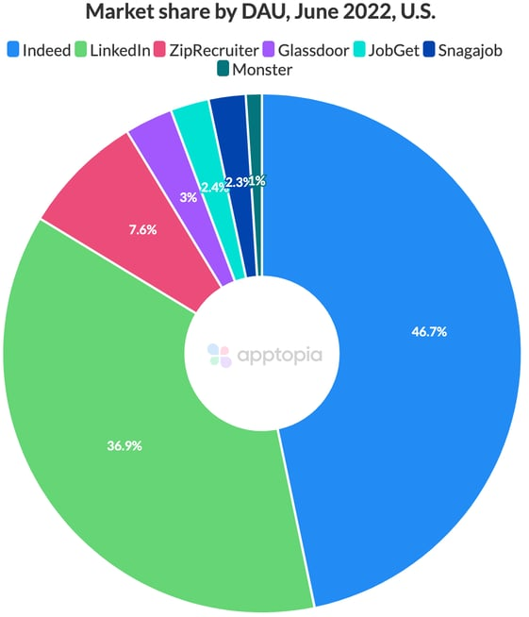

Slide 13
Glassdoor
Glassdoor is a popular job search platform. Features include:
job postings,
company reviews,
salary information
career advice.
Nevertheless, the company reported revenues of about $22 billion for the fiscal year 2018. 14.1 percent of that (or roughly $3 billion) can be attributed to the HR Technology group, which both Indeed and Glassdoor are subsidiaries.
© 2019 Udacity. All rights reserved.

Slide 14
Indeed
Indeed: Indeed is another popular job search platform . Features include:
job postings,
resume upload, and
career advice
Indeed’s revenue is shared as part of the revenue announcements from Recruit Co., the company’s shareholder . For the fiscal year 2018, Indeed posted annual revenues of US$ 2.75 billion
© 2019 Udacity. All rights reserved.

Slide 15
Our Advantages
Why are we better?
Personalized Job Matching: Unlike our competitors, GradMatch will provide a personalized job matching algorithm that will match job postings with user profiles and preferences.
Career Advice and Job Market Insights: GradMatch will provide resume and cover letter review, job market insights, and career advice, which our competitors do not specialize in.
Interview Preparation and Networking: GradMatch will provide interview preparation tips, practice questions, and networking opportunities, which our competitors do not offer. Additionally, GradMatch will offer networking events and opportunities to help users connect with potential employers.
© 2019 Udacity. All rights reserved.

Slide 16
Roadmap and Vision
© 2019 Udacity. All rights reserved.
Notes:
[ALL PARTICIPATION]

Slide 17
Vision
Where do we go from here?
Our vision for GradMatch is to become the NUMBER 1 go-to app for recent college graduates looking for job opportunities that align with their skills and preferences.
When people specifically college graduates speak on entry-level job opportunities, GradMatch should be the first words on their lips.
© 2019 Udacity. All rights reserved.

Slide 18
Theme 1 : Incorporate user feedback into job recommendations
Feature 1: Incorporate user feedback into job recommendations. This feature allows users to give feedback on job recommendations that they receive from the app. Based on this feedback, GradMatch can learn and improve its recommendation algorithms to provide even more relevant and accurate job recommendations to users in the future.
Feature 2: Integrate with other social media platforms to expand user data sources. This feature allows users to connect their other social media profiles, such as Twitter or Facebook, to their GradMatch account. By expanding the data sources available to the app, GradMatch can further personalize job recommendations and offer a more comprehensive view of a user's skills and interests.
© 2019 Udacity. All rights reserved.

Slide 19
Theme 2: Expand User Engagement and Retention
[Subtitle]
Feature 1: Gamify the job search process with badges and rewards for completing certain milestones. This feature adds an element of gamification to the job search process, encouraging users to engage with the app and complete various tasks. For example, users could earn badges for updating their resume or completing a certain number of job applications. This not only improves user engagement and retention, but also helps users stay motivated throughout the job search process.
Feature 2: Add a community forum for users to connect with and support each other. This feature adds a community forum within the app where users can connect with other job seekers, ask for advice, and share their experiences. This creates a sense of community and support among users, which can help improve user engagement and retention.
© 2019 Udacity. All rights reserved.

Slide 20
Theme 3 : Monetize through premium features
[
Feature 1: Offer premium career coaching and interview preparation services for an additional fee. This feature offers users the opportunity to purchase premium career coaching and interview preparation services within the app. These services could include one-on-one coaching sessions with career experts, resume reviews, and mock interviews. This not only generates additional revenue for the app, but also provides users with valuable resources to improve their chances of success.
Feature 2: Partner with employers to offer sponsored job listings for a higher fee. This feature allows employers to pay a higher fee to have their job listings featured more prominently within the app. By partnering with employers, GradMatch can increase its revenue while also offering users a wider range of job opportunities. Additionally, this feature can help employers attract and hire top talent, creating a win-win situation for both job seekers and employers.
© 2019 Udacity. All rights reserved.

Slide 21
Where do we go from here?
Widening the scope
Our next steps include conducting market research and user testing to fine-tune our product features and messaging. We also plan to build strategic partnerships with universities and employers to expand our reach and increase user acquisition. Finally, we will continue to iterate and improve our product based on user feedback and performance metrics.
© 2019 Udacity. All rights reserved.

Slide 22
Sources
https://www.globenewswire.com/en/news-release/2022/02/28/2393171/0/en/USD-43-39-billion-growth-in-Online-Recruitment-Market-by-2027-at-a-CAGR-of-7-1-during-forecast-period-Fortune-Business-Insights.html
https://www.statista.com/statistics/633660/unemployment-rate-of-recent-graduates-in-the-us/
https://educationdata.org/number-of-college-graduates
https://time.com/6202331/college-graduates-job-market/
https://ng.indeed.com/
https://www.glassdoor.com/index.html

